Slide 1
Summarizing and Visualizing Data
Problem: “Big data” and often no given (probability) model
Convenient to summarize the data by processing it
Most common examples are
Sample mean (average)
Sample variance
Sample covariance
Sample moments
Mode
Quantiles, order stats., and sample median
Histogram
These can be viewed as “estimators” in a probabilistic model
Or, simply descriptive statistics, with no reference to a model

Slide 2

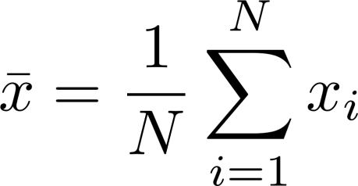
Sample Mean
Given
Represent entire data with one number
“Average” of data
Due to LLN, approximates the expected value
It is the ML or MAP estimator in many (e.g., Gaussian) cases

Slide 3
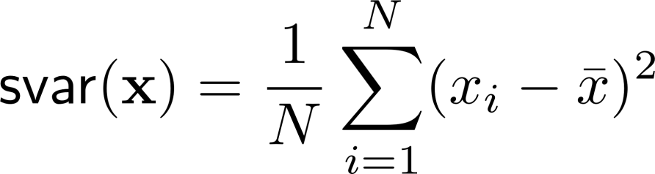
Sample Variance
“Variability” of data around the sample mean
Square root yields sample std
Due to LLN, approximates the variance
It is the ML or MAP estimator of variance for some prob. models

Slide 4
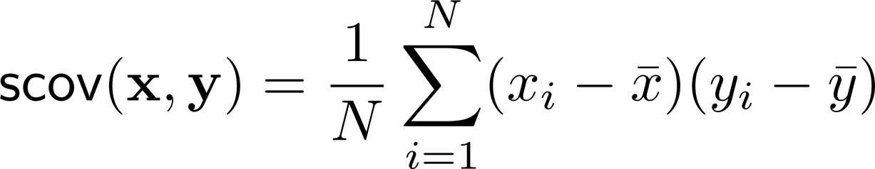
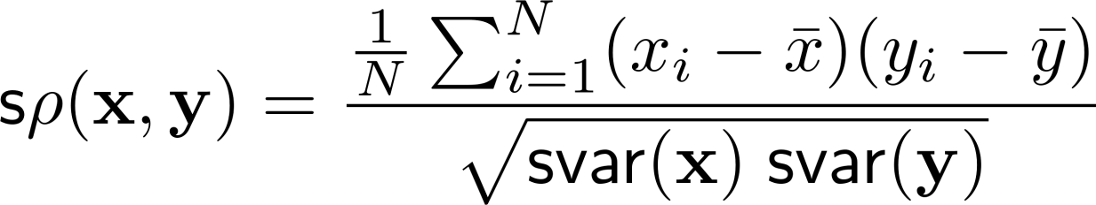
Sample covariance
Given
Due to LLN, approximates the covariance
It is the ML or MAP estimator in some cases
Can be normalized by sample variance(s) to approx. the corr. coeff:

Slide 5
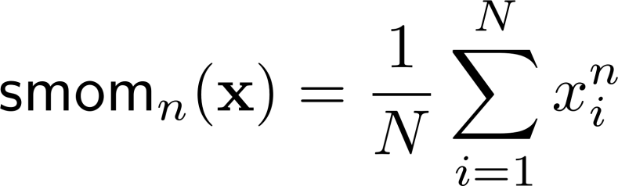
Other Sample Moments
Due to LLN, approximates the nth moment
It is the ML or MAP estimator in some cases
Can be used to estimate important quantities (we will not cover) such as
Cumulants
Skewness
Kurtosis

Slide 6
Sample Mode
… or just “mode”
The most often occurring value in a set of data
Not very meaningful if distribution is continuous
In the discrete case, is an estimator for the location of max of PMF

Slide 7





Order Statistics and Related Quantities
Given
One can rank the data from larges to smallest
These are “order statistics”
From this list one can extract
Max
Min
Median (50% are bigger, 50% smaller from median),
Quantilies (instead of 2 equal groups break it up into more)
The median is similar to the mean
Much less sensitive to “outliers” (e.g. income distribution)
Median filtering in image processing due to “salt-and-pepper noise”
What happens to the median when a new sample
with a very large value is added?
What happens to the sample mean?

Slide 9
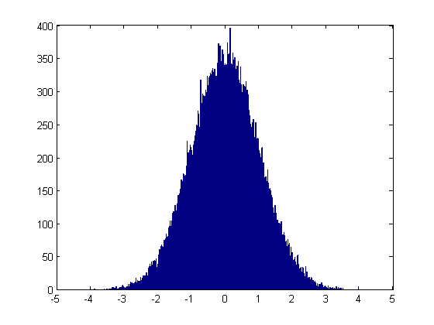
Histogram
A graphical representation of “frequency distribution”
AKA bar graph
A more complete description of the data than mean and variance
Can be thought of as an estimate of PDF or PMF
Needs some smoothing
Has the info on sample (mean, median, mode, quantiles etc)

Slide 10
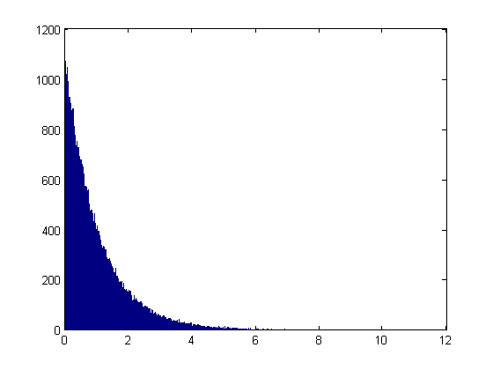
Histogram (Cont’)
Matlab command “hist”
e.g., hist(randn(1,100000),1000), (prev slide) or
hist(-log(1-rand(1,100000)),1000) (below)

Slide 11
Acknowledgements and Citations
Parts of these slides are adapted from the following resources:
Power Point Lecture Slides for the Textbook http://bcs.wiley.com/hebcs/Books?action=index&bcsId=8676&itemId=1118324560
John Tsitsiklis. 6.041 Probabilistic Systems Analysis and Applied Probability, Fall 2010. (Massachusetts Institute of Technology: MIT OpenCourseWare),http://ocw.mit.edu (Accessed 13 Apr, 2015). License: Creative Commons BY-NC-SA

